Slide 1

Smart Queue Management System
for Health Care

Slide 2

Fakhra Najm
Dhruv Tomar
Mayank Dutta
Presented by

Slide 3
Prof. Shabana Mehfuz
Guided By

Slide 4
Overview

Slide 5

What we going to discuss today?
Existing solution
Problems
Why Problems
Proposed Solution
Conclusion
References

Slide 6

What we going to discuss today?
Existing solution
Problems
Why Problems
Proposed Solution
Conclusion
References

Slide 7

What we going to discuss today?
Existing solution
Problems
Why Problems
Proposed Solution
Conclusion
References

Slide 8

What we going to discuss today?
Existing solution
Problems
Why Problems
Proposed Solution
Conclusion
References

Slide 9

What we going to discuss today?
Existing solution
Problems
Why Problems
Proposed Solution
Conclusion
References

Slide 10

What we going to discuss today?
Existing solution
Problems
Why Problems
Proposed Solution
Conclusion
References

Slide 11

Management of Queue

Slide 12
The APPOINTMENTS
First and Foremost method

Slide 13

Appointment System
Organize patients only one time.

Slide 14

Patients assigned more priority as they arrive.
Patients
1 | 2 | 3 | 4 | 5

Slide 15
Information noted in order of their visit.
Patients
1 | 2 | 3 | 4 | 5

Slide 16
Appointments completed !!
Queue ready for next day.
Patients
1 | 2 | 3 | 4 | 5

Slide 17
Fakhra

Slide 18

Problems !
Why SQMS?

Slide 19

Problems
No Standard System

Slide 20
Every Hospital has his own methods.
Patients have to gather information before visit.

Slide 21

Problems
Long Queues

Slide 22
New and unaware patients reach before time.
Creates chaos.

Slide 23

Problems
No Proper Organization for
Latecomers.

Slide 24
Whom to prioritize
Where to put the latecomer in case he arrived.
1 | 2 | 3 | 4 | 5
1 | 2 | 3 | 4 | 5
As doctor done with Patient 4
Absent
Doctor at
Turn of Patient 5
Present

Slide 25
Mayank

Slide 26
Solution
Assign a Dynamic priority.

Slide 27
Another Parameter
Assign priority in the appointment order
Appointment Order
Patient 1 | Patient 2 | Patient 3 | Patient 4 | Patient 5 | Patient 6
Priority
1 | 2 | 3 | 4 | 5 | 6

Slide 28

Keep Record of Patients
Appointment Order
Patient 1 | Patient 2 | Patient 3 | Patient 4 | Patient 5 | Patient 6
Priority
1 | 2 | 3 | 4 | 5 | 6

Slide 29

Assign Penalty
Appointment Order
Patient 1 | Patient 2 | Patient 3 | Patient 4 | Patient 5 | Patient 6
Priority
1 | 2 ( + 2) | 3 | 4 | 5 | 6

Slide 30
Assign Penalty
Appointment Order
Patient 1 | Patient 2 | Patient 3 | Patient 4 | Patient 5 | Patient 6
Priority
1 | 4 | 3 | 4 | 5 | 6

Slide 31

Re-order
Appointment Order
Patient 1 | Patient 3 | Patient 2 | Patient 4 | Patient 5 | Patient 6
Priority
1 | 3 | 4 | 4 | 5 | 6

Slide 32

Final Queue
Appointment Order
Patient 1 | Patient 3 | Patient 2 | Patient 4 | Patient 5 | Patient 6
Priority
1 | 3 | 4 | 4 | 5 | 6

Slide 33
How this is helping?

Slide 34

How this is helping?
Fixing the Position of latecomers.
Appointment Order
Patient 1 | Patient 3 | Patient 2 | Patient 4 | Patient 5 | Patient 6
Priority
1 | 3 | 4 | 4 | 5 | 6

Slide 35
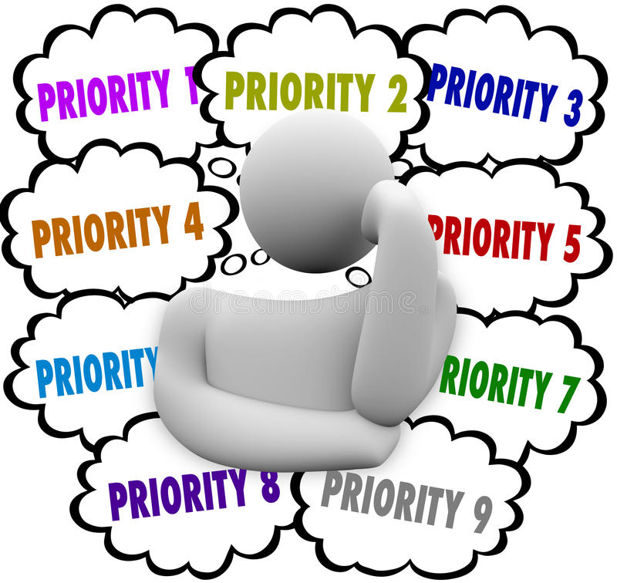
How this is helping?
Resolving issue of Prioritization.
Appointment Order
Patient 1 | Patient 3 | Patient 4 | Patient 5 | Patient 6 | Patient 2
Priority
1 | 3 | 4 | 4 | 5 | 7

Slide 36
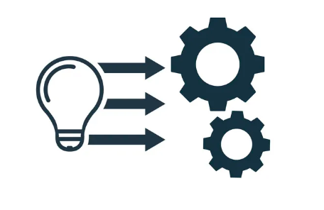
Implementation

Slide 37

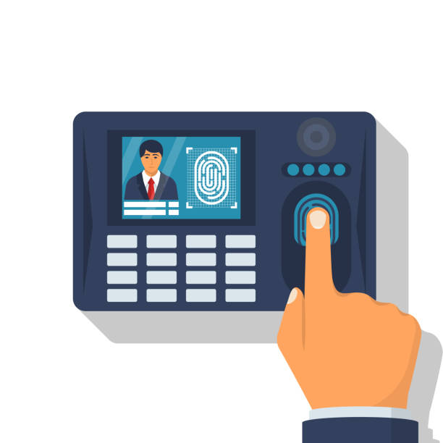
As Doctor will arrive, he will mark his presence using Biometrics.
Smart Queue Management system will upload his presence on the cloud.

Slide 38

As Doctor will arrive, he will mark his presence using Biometrics.
Smart Queue Management system will upload his presence on the cloud.
As Cloud receive the response from Biometrics system.
It will let respective users know.

Slide 39


As Doctor will arrive, he will mark his presence using Biometrics.
Smart Queue Management system will upload his presence on the cloud.
As Cloud receive the response from Biometrics system.
It will let respective users know.
Users can see the presence of Doctor from web app.
And thereafter can plan to reach clinic accordingly.

Slide 40

System Architecture
of SQMS

Slide 41
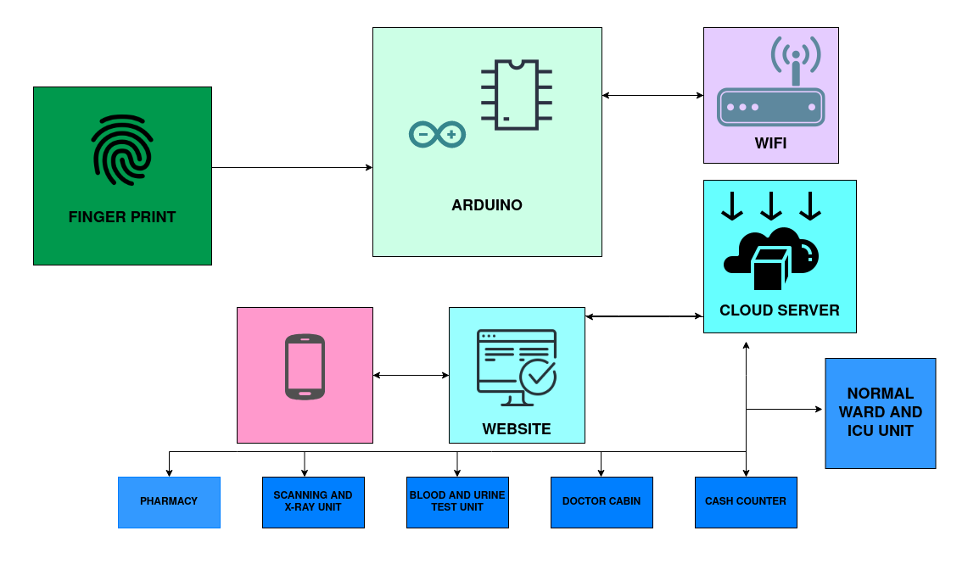

Slide 42
Conclusion
​
Implementing this solution will correctly Prioritize each patient.​
Time of the patients are valued.​
Needs of the patients, staff and hospital authorities are covered.​
Interaction inside a Queuing System becomes easy and convenient

Slide 43
References
Sumit Soman; Sudeep Rai; Priyesh Ranjan; Amarjeet Singh Cheema; Praveen K Srivastava “ Mobile-Augmented Smart Queue Management System for Hospitals”, International Symposium on Computer-Based Medical Systems (CBMS), September 2020
Supriya Burungale, Komal Kurane, Sakshe Mhatre, “Patient Queue Management System” ,International Journal of Engineering Science Invention, volume 7, issue 2, February 2018
M. Ngorsed and P. Suesaowaluk, “Hospital service queue management system with wireless approach,” in Frontier Computing. Springer, 2016,pp. 627–637
Prof. D. V. Chandran, Divya Patil, Pooja Galande, Arati Ghutukade, “ Multiple Queue Management With Real Time Tracking For OPD Scheduling In Hospitals”, International Journal for Research in Engineering Application & Management, Volume 3, isuue 2, April 2017
Zero Queue Maintenance System using Smart Medi Care Application for Covid-19 Pandemic Situation, Third International Conference on Intelligent Communication Technologies and Virtual Mobile Network

